Slide 1
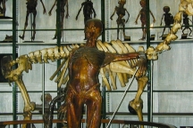
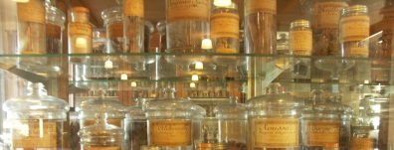
implementing the HR strategy for Research (HRS4R)
The Université de montpellier experience
Notes:
I would like to thank the European Commission and the DG Research and the Ministry of Education and Research of Bulgaria, the Ministry of Research and Innovation of Romania for their invitation and for the opportunity they are giving me today to present UM’s experience with HRS4R.

Slide 2
Table of contents
Overview of Université de Montpellier
Why UM entered the HR award process
Our challenges
Who contributed and how
Tips and tricks
Impact and benefits
Notes:
After a brief overview of UM, I will point the motivations to engage in such a path, I’ll mention the main challenge we had to face and how we overcame it. Then I’ll describe the process we followed indicating key contributors, methodology and calendar. I will conclude with the benefits encountered so far, and how HRS4R positively impacts ‘Mobility of the mind’

Slide 3
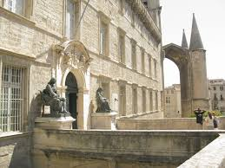
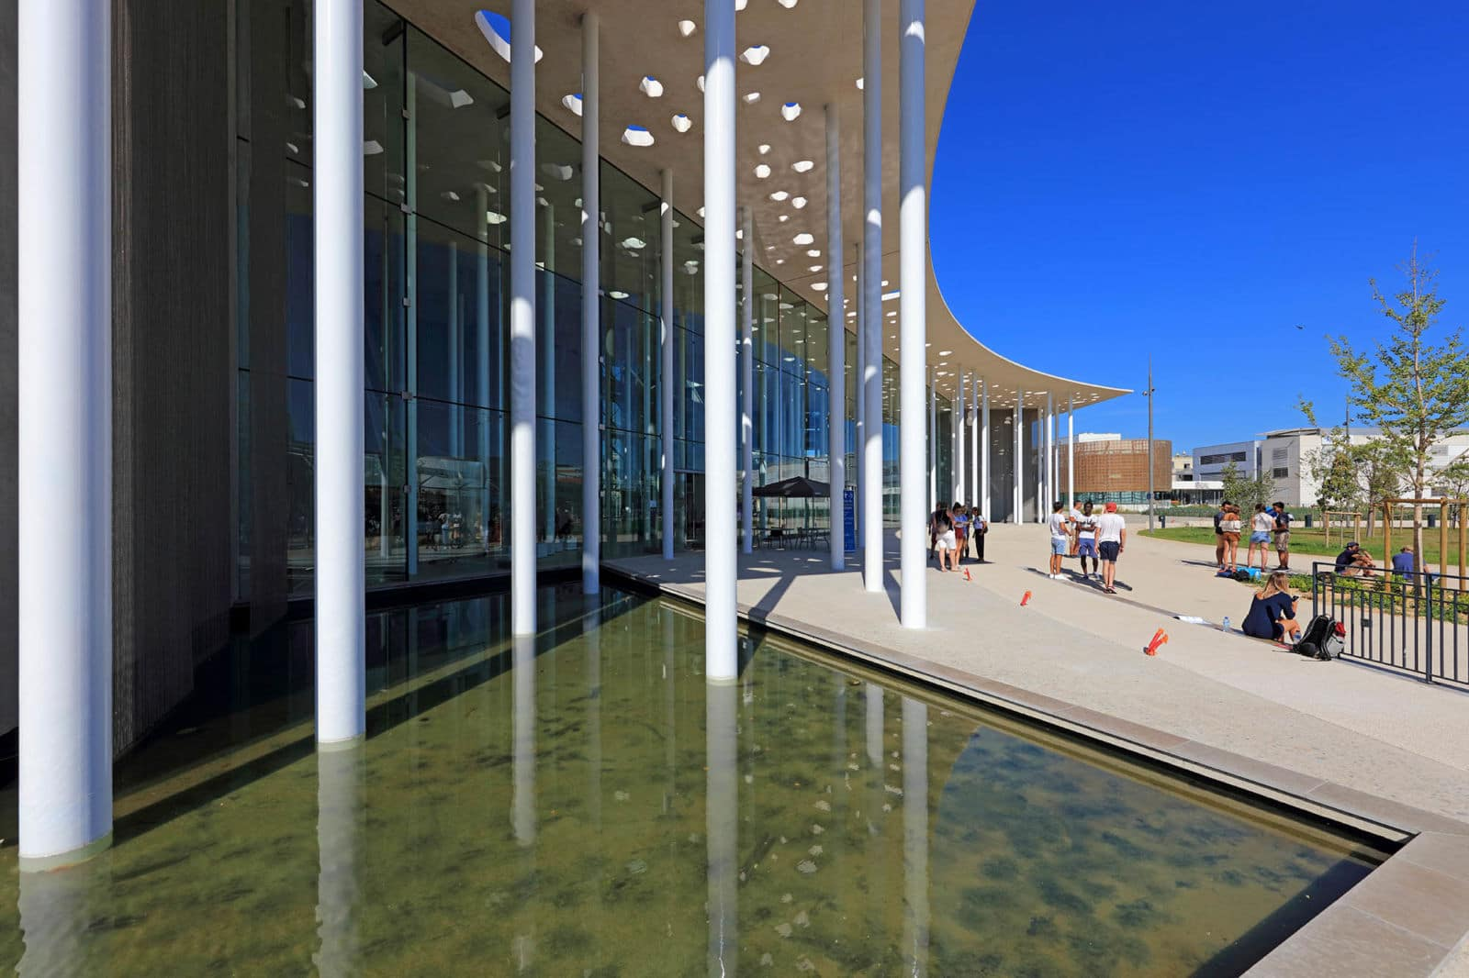
1. Overview of Université de Montpellier (1/2)
A medieval university heading towards the future
Young: created 1 January 2015 (merge of UM1-UM2)
Old: oldest School of Medicine in activity in the Western world (1289)
Extensive community of knowledge: sciences, techniques, medicine, environmental & educational science, law, management, economics & political science
“Better research talent management” EC workshop – Sofia, Bulgaria

Slide 4
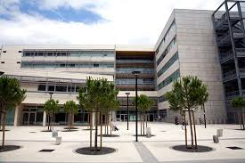
1. Overview of Université de Montpellier (2/2)
Key figures
6th largest French university
46,000 students (1,800 PhD students with 50% coming from abroad)
16 schools
77 research units
MUSE I-SITE
coordinated by UM
4,300 researchers (of whom 2,400 are hosted)
Budget 400 M €
“Better research talent management” EC workshop – Sofia, Bulgaria

Slide 5
2. Why UM entered the hr award process
Coherent with UM’s general strategy plan
Part of institution’s research strategy
Desire to increase national and international exposure
Means to acknowledge UM’s prominent position as research intensive university
Process initiated in 2007 but not completed
Opportunity
Curious to measure the gap yet to fill….
Volunteer-based, risk-free, no-added cost process
No university and only 1 institution with award in France (at the time)
“Better research talent management” EC workshop – Sofia, Bulgaria
Notes:
UM involved in many mobility programs for staff and students

Slide 6
3. Our challenges
Merging context
Very critical and busy time
Hesitant to add more work or change
Turned into perfect opportunity to
Contribute to building a common identity
Set improved standardized practices in the newly created institution
Stand out as innovative and attractive employer for research in France and internationally
Extend HRS4R to all UM employees from the beginning (not just researchers)
“Better research talent management” EC workshop – Sofia, Bulgaria

Slide 7
4. Who contributed and how
A Steering committee
A Working group
Vice-presidents of:
Research
International Relations
Education and Academic Life
University’s Social Responsibility
Property Management strategy & Information Services
Project Manager
Project manager
Representatives from:
Human Resources
Research & Doctoral Studies
Innovation and Partnerships
General and Institutional Affairs
International Relations
Campus Life
Steering
Panel of researchers
“Better research talent management” workshop – Sofia, Bulgaria
Notes:
Researchers: confirmed researchers (Professors), Assistant Professors, Doctoral School director

Slide 8
4. Who contributed and how
Top-down and bottom-up approach
Distribution of C&C items according to working group member’s expertise)
All 40 items for researchers’ panel members
Gap analysis (check applicable regulations and internal UM policies for each item)
Proposals for improvement measures
Working Group sessions
Compilation and discussion of resulting observations, strategy
elaboration
Validation by Steering Committee
Writing
+
Publication
on UM website
(FR & EN)
7-month process (July 2014 – January 2015)
“Better research talent management” EC workshop – Sofia, Bulgaria

Slide 9
5. Tips & Tricks
1. Create the Working group
Someone experienced with transversal project management for efficiency
If possible, have a bilingual person on your team for proposal writing part
Breakdown work in sub-groups (faster and more effective)
Including the research community is mandatory
2. Start the process
Send an endorsement and a commitment letter to the attention of Carlos Moedas, European Commissioner at RTD-CHARTER@ec.europa.eu
Letter must be signed by top executive representative (President, Dean, or VP of Research)
1 year timeframe to submit your proposal under the strengthened HRS4R!

Slide 10
5. Tips & Tricks
3. Gap analysis
Complete template 1 (and OTM-R* annex)
Items order in Gap Analysis template is different than in C&C!
Map national laws/regulations and your institution’s internal pratices
Check with your Ministry of Education/Research for list of existing national rules
Assess all 40 items (mandatory)
Report strengths/weaknesses under the 4 thematic areas:
I – Ethical and professional aspects (items 1 to 11)
II – Recruitment and selection (items 12 to 21)
III – Working conditions and social security (items 22 to 35)
IV – Training and Development (items 36 to 40)
Identify areas of improvement
Other templates on Euraxess are great source of input
Template 3 – Internal review report
Templates A-B-C (experts’ assessment report)
*OTM-R : Open Transparent Merit-based Recruitment

Slide 11
5. Tips & tricks
4. Elaborate HR strategy & action plan
Use template 2 (HR Strategy & action plan)
Complete requested data (figures)
Link actions to observed gaps
Present your plan under the 4 thematic areas
First action plan covers 2 years
Embed OTM-R actions in your HR Strategy
Identify stakeholders in charge of carrying out the plan
Provide a delivery date per action (at least per Quarter or Semester/year)
Include indicators and monitoring plan to facilitate follow-up
Summarize your action plan with a table or GANTT chart

Slide 12
6. Tips & tricks
5. Publish your HRS4R documents
Letter of commitment
Completed templates 1 & 2 (with OTM-R)
On your institutional website
In English and in your national language
In a visible area of website
In relations to Research and/or HR
Send to RTD-CHARTER@ec.europa.eu
All English-language documents (templates and annexes)
Regroup into ONE PDF for assessment
Include a Cover letter containing the following terms: «… the information presented in the application (including qualitative and quantitative data) is an honest, accurate and true representation of the institution »
No more cut-off dates or cohorts

Slide 13
6. Impact and Benefits
From a global point of view
Increased national and international exposure and attractiveness (First French university with award)
UM overall rankings went up (50 spots in 2016 QS ranking; 62nd world most innovative university, Reuters 2017)
Wider recruitment base:
job openings published on Euraxess Jobs
portal flagged with ‘HR Excellence in Research’ logo
relayed on ‘Nature’ and ‘Science’ websites
Alignment with EC funding requirements: Article 32 of Grant Agreement on mandatory implementation of the Charter & Code principles in H2020
Priority for EC grant attribution in case of ex-aequo ranking for calls-for-tender
“Better research talent management” EC workshop – Sofia, Bulgaria

Slide 14
7. Impact and Benefits
From an institutional point of view
Implementing HRS4R contributes to promoting internationalization in an institution
Presentations on HRS4R to both administrative and research staff
Raise awareness of international context to all staff (including ‘non-mobile’-minded staff)
HR award and acknowledgement of UM’s HRS4R by EC help accept this mindset
Supports open-mindedness: have to think outside the box
Use of HR Excellence logo in signatures and letterhead is a daily reminder
Showcases efforts from other departments that are in line with C&C principles
“Better research talent management” EC workshop – Sofia, Bulgaria

Slide 15
Conclusion
C&C and HRS4R principles
Researchers at the core of process
Improve researchers’ status and career conditions
Create favorable conditions for research career
Research careers
HRS4R
C&C
Take into account all aspects of research work (mobility, supervision, management, teaching, dissemination, science popularization and more)
Researchers’ input is essential
To everyone’s benefit!

Slide 16
Download UM’s HRS4R for more details
http://www.umontpellier.fr/wp-content/uploads/2017/05/8-Original_UM_Strategy_EN_FINAL.pdf
Thank you for your attention!
CONTACT: NATHALIE MODJESKA
Head of Research Projects Support Office
Innovation and Partnerships Department
Université de Montpellier
nathalie.modjeska@umontpellier.fr -  +33 (0)4 67 14 48 80
“Better research talent management” EC workshop – Sofia, Bulgaria

