Slide 1
The Human Resources Strategy for Researchers (HRS4R) How to implement the principles of Charter and Code? Sofia (BG) – 17 October 2017
Dr Irmela Brach
Policy Officer - DG RTD B.2
Open Science and ERA Policy

Slide 2
READ the documents !

Slide 3
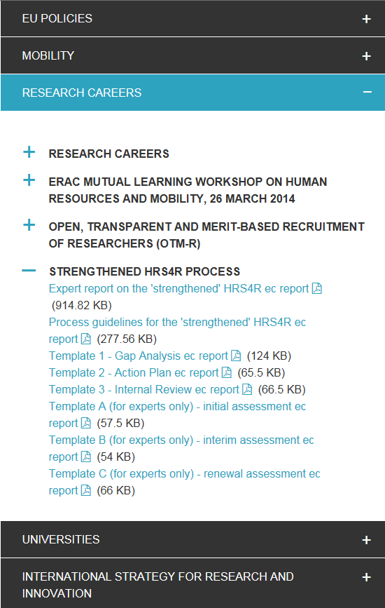
https://euraxess.ec.europa.eu/useful-information/policy-library
TEMPLATES
for institutions
TEMPLATES
for assessors

Slide 4
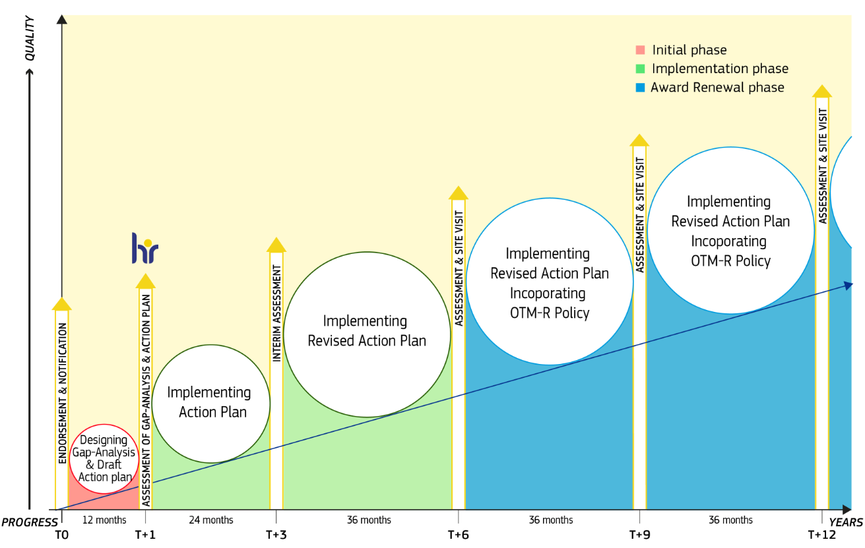
HRS4R procedure
THIS IS
WHAT YOU NEED TO KNOW !!!

Slide 5
T0
STARTING
Endorsement of C&C principles
Notification of commitment (to implement)
One single letter
(starting the clock)
LETTER
of endorsement &
notification
of
commitment
signed by the
highest representative
of the institution
RTD-CHARTER@ec.europa.eu

Slide 6
T0 => T+1 (12 month)
INITIAL phase
TEMPLATES
are
MANDATORY
DESIGNING the:
GAP-analysis (on template 1)
identify gaps between current policies and practices versus the 40 Principles of C&C
draft ACTION plan (on template 2)
propose actions to tackle the identified gaps
Applicants are required to confirm in their accompanying letter that the information presented in the application (including qualitative and quantitative data) is an honest, accurate and true representation of the institution.

Slide 7
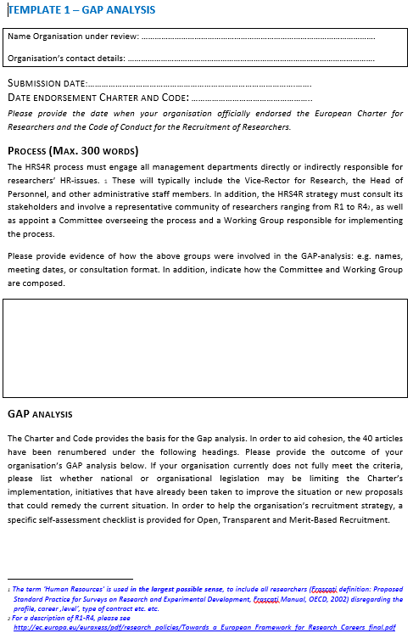
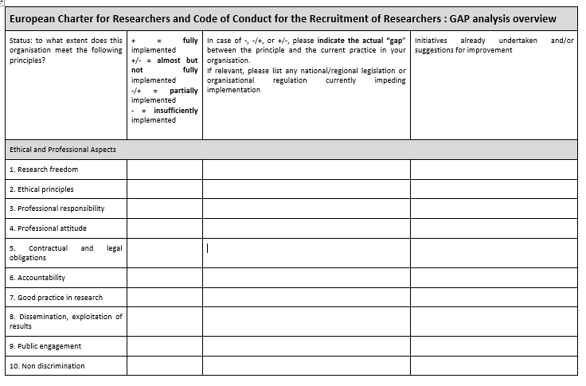
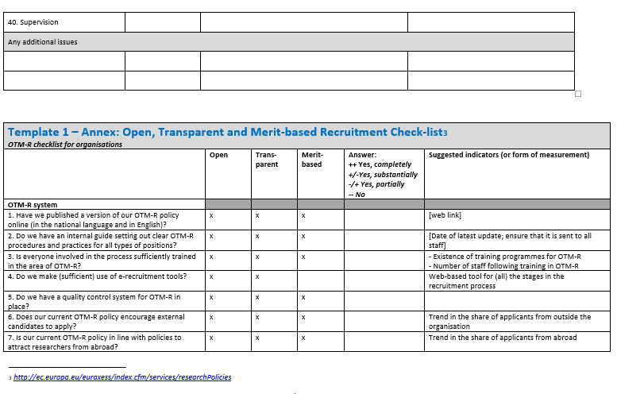
INITIAL phase
Template 1 = GAP-analysis including process description, checklist for C&C and OTM-R
C&C principles, assessment & gap identification
Endorsement date C&C
Process description: HOW did you carry out gap analysis?
OTM-R checklist & gap identification

Slide 8
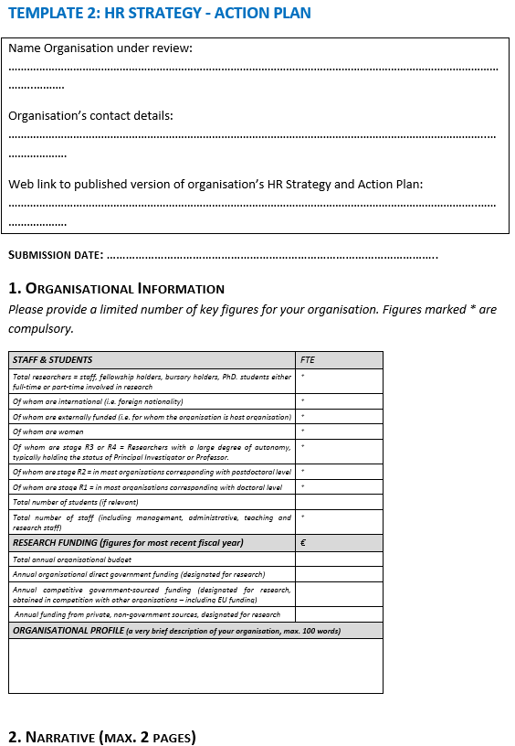
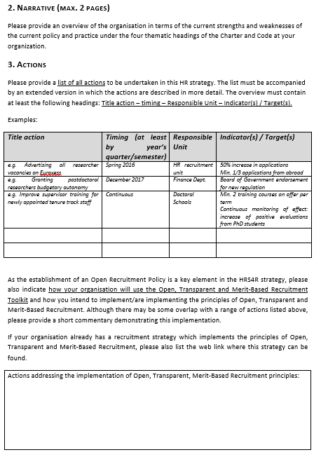
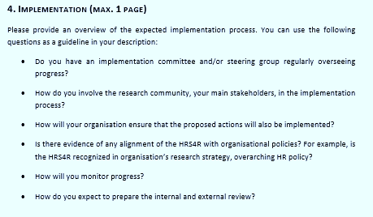
INITIAL phase
Template 2 = Action plan incl. organisational information, narrative, actions & implementation
Narrative (SWOT-analysis)
HRS4R weblink
Implementation plan
List of actions related to C&C
Key facts & figures
Specific actions related to OTM-R

Slide 9
What assessors do…
1. Eligibility criteria: (usually EC checks eligibility)
If C&C signed more than 1 year before HRS4R submission: not acceptable for newcomers.
If different setting, mention it
Is HRS4R published on website in English?
If there but hard to find, make a recommendation (not a reason for penalizing)
Full gap analysis does not need to be published!
Is the submission complete, i.e. the two templates (Gap-analysis + action plan)?
Is there a letter or other evidence of institutional endorsement?
Quality assessment
Overall judgment
Recommendations

Slide 10
T+1
Assessment CRITERIA:
Sufficient and clear overview of the organisation
Clear, detailed and comprehensive explanatory text (i.e. narrative) on the state of play of the four thematic areas of the Charter and Code at the institution
Actions for the implementation of the principles of the Charter and Code
Examples of how the implementation of the HRS4R Action Plan and the Charter and Code are being further embedded in the institution.

Slide 11
T+1
OUTCOME of the assessment :
Accepted
The institution meets the criteria and the ‘HR Award’ is granted by the Commission services. The experts may comment on the submission asking for future focus on a particular aspect/criterion, if appropriate. For example, they may say that they would like to see something addressed in the longer term, but acknowledge that the submission meets the criteria for the Award.
Accepted pending minor alteration
The institution broadly meets the criteria but the external Assessment Panel has some concerns/questions about specific areas/criteria, in which case the institution should reflect on the feedback, update the documentation and revert to the relevant authority, ideally, within 1-2 month.
Declined pending (major) revisions
The institution does not meet the criteria, but the institution can make the appropriate changes and re-submit its application after 9-12 months (NOT BEFORE). When these are implemented and positively assessed under a new assessment the HR award is granted.
X

Slide 12
T+1=> T+3 (24 month)
IMPLEMENTATION phase
IMPLEMENTING the ACTION plan
keep to proposed timeline to implement the actions
prepare your self-assessment/internal review (on template 3) for the INTERIM ASSESSMENT
Use the TEMPLATES

Slide 13
T+3
INTERIM ASSESSMENT:
undertaken by external experts / peer reviewers
based on self-assessment / internal review prepared by the institution
justify altered actions & revised timeline
show progress and quality of the actions
detail accompanying measures (i.e. embedding the HR strategy into the institutions policies)
detailed assessment
quality of progress (intended and obtained)
strengths and weaknesses of the HR strategy
At this point of the interim assessment, the participating institution does not jeopardise maintaining the 'HR award', but receives detailed feed-back for the next period.

Slide 14
T+3 => T+6 (36 month)
IMPLEMENTATION phase
IMPLEMENTING the revised ACTION plan
peer review by international independant external experts
based on self-assessment / internal review prepared by the institution
prepare your self-assessment / internal review for the ASSESSMENT & SITE VISITS (at T+6)
Use the TEMPLATES

Slide 15
T+6
ASSESSMENT & SITE VISIT:
undertaken by external experts / peer reviewers
Assessment:
based on self-assessment / internal review prepared by the institution (same as for T+3)
Site visit:
meeting (confidential) key stakeholders (incl. researchers, management & practitioners)
discuss issues and questions from the analysis of the self-assessment document

Slide 16
T+6 => T+9 (36 months)
RENEWAL phase
IMPLEMENTING the revised ACTION plan incorporating OTM-R policy
peer review by international independent external experts
based on self-assessment / internal review prepared by the institution
prepare your self-assessment / internal review for the ASSESSMENT & SITE VISITS (at T+9, T+12 etc.)
Use the TEMPLATES

Slide 17
HERE you are today !
HERE
you will be soon !
HERE you go!

Slide 18
Success will be yours !
Успехът ще бъде ваш !
Succesul va fi al tău !
Thank you for your attention

